Slide 1
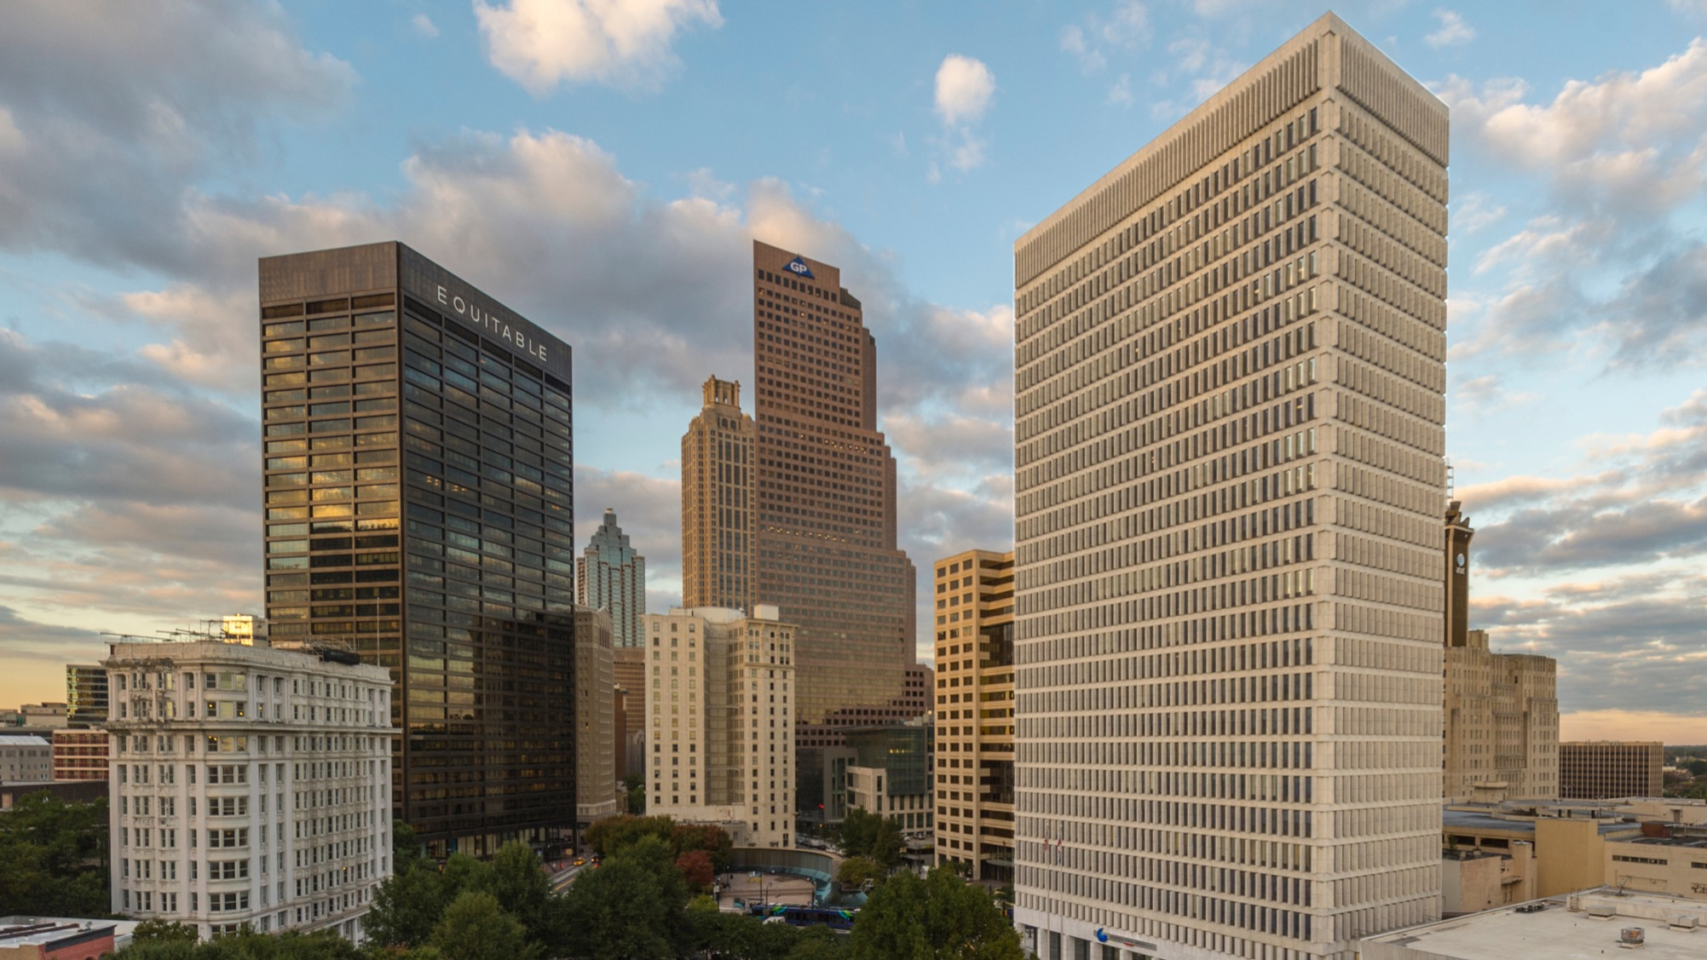

12/01/2022 – Graduate Project Defense
Detection of Parkinson’s Disease from handwriting kinematics feature extraction using ML classification algorithms
Name of presenter
Hari Priya Vuppu

Slide 2
Introduction
What is Parkinson Parkinson’s disease is a complex neurodegenerative disease that affects a large portion of the worldwide population. With current prevalence rates, ranging from 10 to 800 people per 100,000, PD is one of the most common neurodegenerative disorders.
What is the Problem? There is currently no objective method for diagnosing PD. It can take months to get a reliable PD diagnosis, and symptoms need to be carefully monitored. Even then the probability of an inaccurate diagnosis is approximately 25%.
What do we do? We used the Parkinson’s disease handwriting (PaHaW) database. The results confirmed that handwriting is relevant in diagnosing and monitoring PD.

Slide 3
Dataset Description
For this project, the ‘Parkinson’s Disease Spiral Drawings Using Digitized Graphics Tablet Data Set’ database from UCI Machine Learning Repository was made use of. This consists of 77 patient records where 62 people have PD and 15 are healthy individuals. The drawings of spirals are included in the dataset as images.

Slide 4
Features Extraction
Feature Extraction was performed, and the following features have been considered for further analysis : 1. No. of strokes 2. Stroke speed 3. Velocity 4. Acceleration 5. Jerk 6. Horizontal velocity/acceleration/jerk 7. Vertical velocity/acceleration/jerk 8. Number of changes in velocity direction 9. Number of changes in acceleration direction 10. in-airtime 11. on-surface time

Slide 5
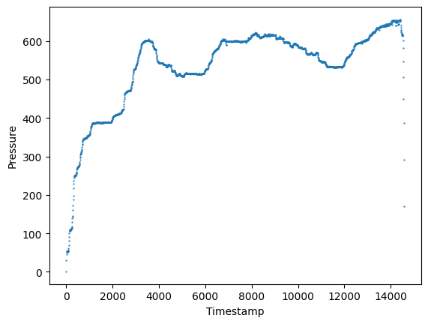
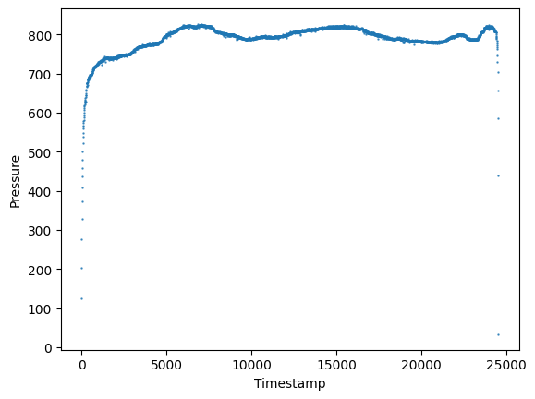
Sample Attribute Difference between affected and normal

Slide 6
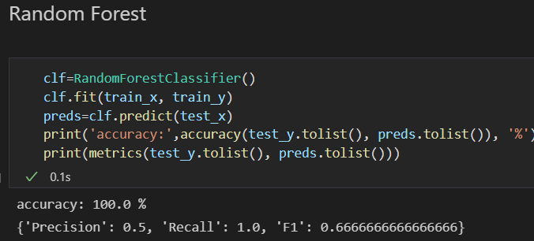
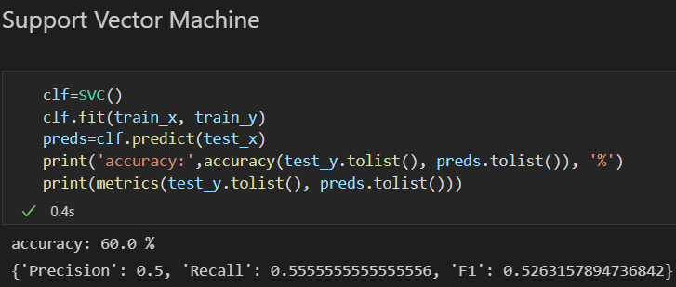
Classifiers used and results

Slide 7
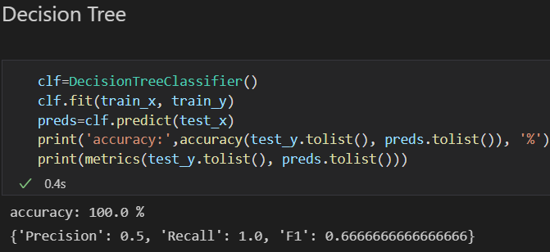
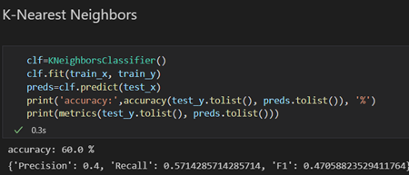
Classifiers used and results

Slide 8
Conclusion
Since Random Forest Classifier had higher sensitivity than the decision tree and does not overfit as it does for the decision tree, we choose Random Forest Classifier as our classification model.
accuracy: 100.0 %
{'Precision': 0.5, 'Recall': 1.0, 'F1': 0.6666666666666666}

Slide 9
Visual Representation of the result

Slide 10
Future Developments
This can also be further developed by scanning text beside the spiral test. This algorithm can be integrated into mobile devices which might help in immediate diagnosis when required. Furthermore, sensors can be placed on the body of the potential patient or in the surrounding environment of the person as a daily usable device to first and foremost diagnose the disease and thereafter regularly monitor the progress of it which would help the doctors take early action.

Slide 11
Thank you

